Slide 1

ONTARIO SCHOOL RESEARCH PROJECT
Amy Dryden, Alessandro Mori, Khemaka Oo, Arti Bhatia

Slide 2
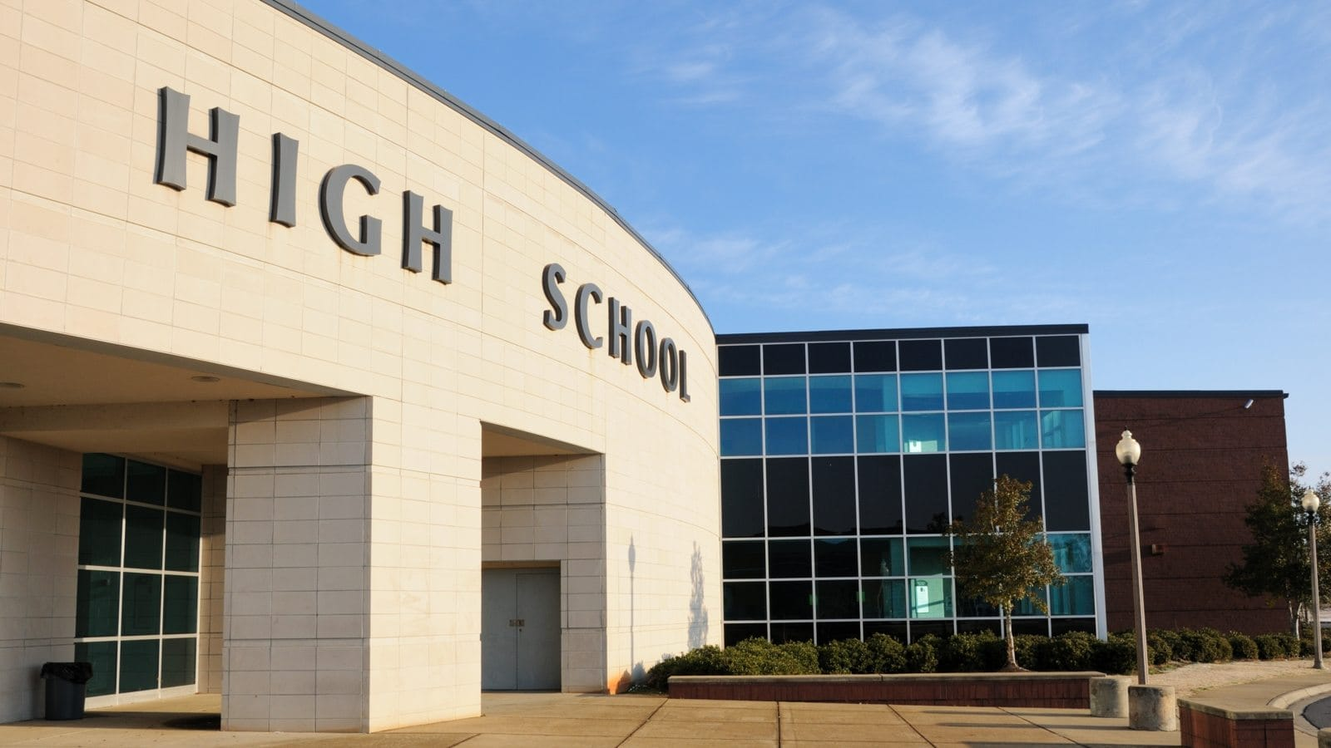
Our Goal
We wanted to research the potential life decisions that youth take regarding their educational careers.
We decided to geographically look at specifically Ontario and schools within this province.

Slide 3
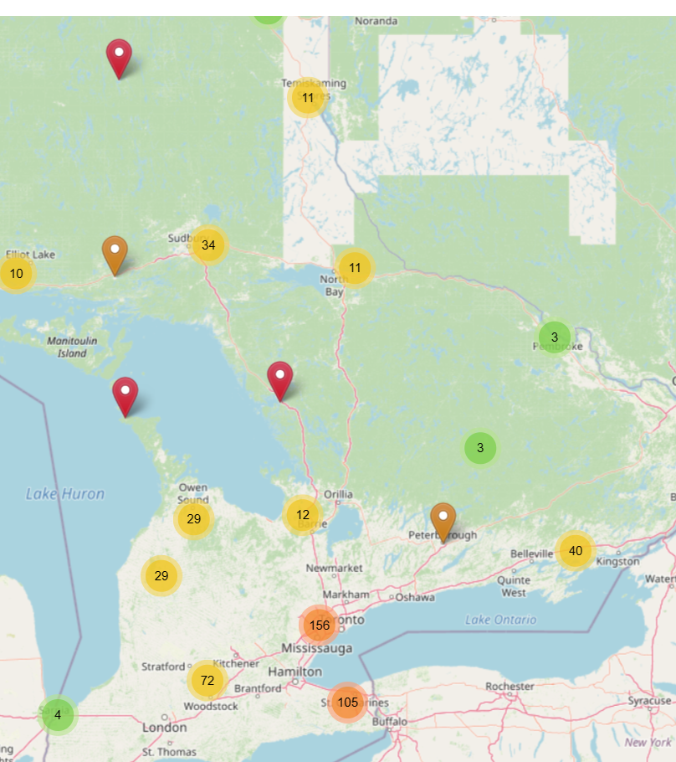
MAps
Our Streetmap shows Elementary and Secondary School markers.

Slide 4
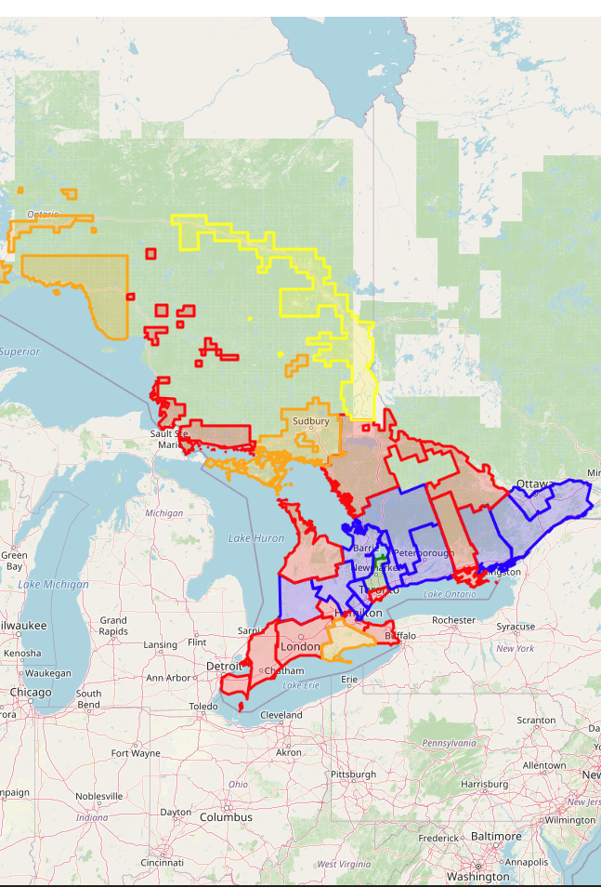
MAPs
Our interactive streetmap shows the rates of graduation for schools across Ontario.
The colourscale reflect the rates of graduation. The colour yellow shows the lowest rates of graduation. The green regions reflect the highest graduation rates.

Slide 5

Enrollment and Graduation Rates in Ontario have been high within the last 4-5 years.

Slide 6
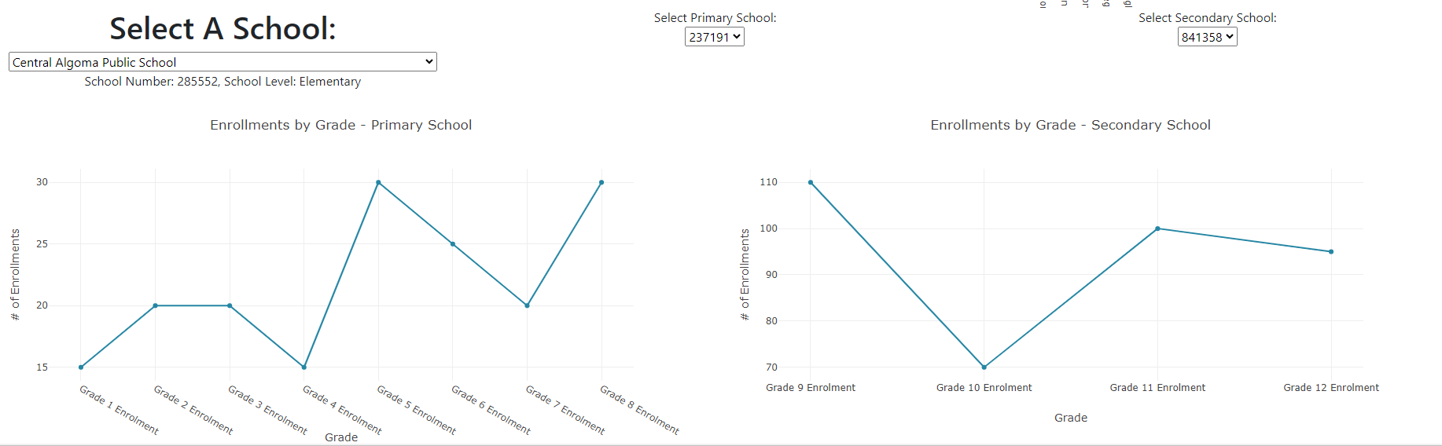
Enrollment rates
The data in the graphs look at school enrollments by grade level and the top 10 schools with enrollment rates.

Slide 7
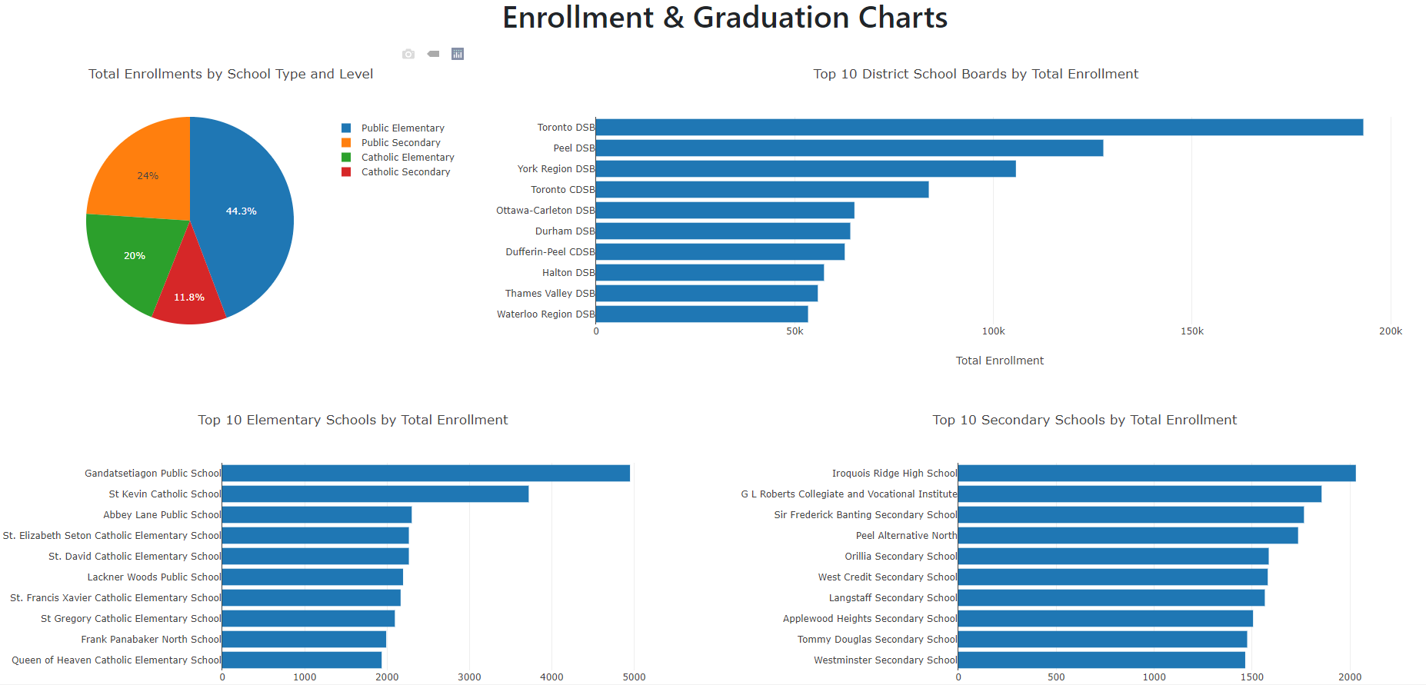

Slide 8
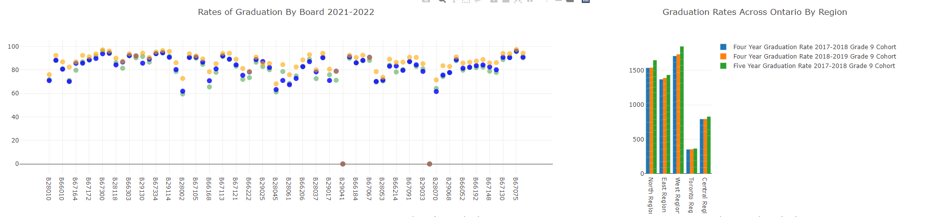
Graduation RATES
The data shows the rates of graduations versus the number of school boards. The second graphs shows rates of graduation by region in Ontario.

Slide 9

HTML webpage LINK
Let us demonstrate by giving you a quick tour of our webpage.

